Slide 1
{Insert Organisation Name Here}
Cloud Data & Analytics Platform Capability Assessment
{Insert Author Here}

Slide 2
Assessment Approach
  “To what extent does organisation’s current state align with a benchmark model of data and analytics maturity”
  The benchmark model can be found at:
  https://github.com/microsoft/azure-data-services-go-fast-capability-assessment
Notes:
First approach assumes little focus on capability uplift and delivery of features that will accelerate future analytics workloads.
Second approach assumes major focus on capability uplift.

Slide 3
Data Lake Variant Assessment

Slide 4
Data Lake Accelerator Variant Summary:
Assumptions: Information gathered via workshops with SME’s. No code review conducted.
Findings: Current implementation is at the lower end of the scale of maturity. When assessed against the benchmark of 52 feature items there are 6 items fully implemented and 6 items partially implemented. The overall feature complete score is 16.98%.
Recommendation: Utilise an ADS Go Fast implementation to rapidly uplift data lake and data pipelining capabilities.
Implementation of an ADS Go Fast framework would be significantly more efficient both in terms of cost and time than evolution and further development of the existing framework.
Typical ADS Go Fast project implementations are 4-6 weeks.
Typical implementation cost is 35k AUD.
ADS Go Fast Implementations may be eligible for funding via Microsoft ECIF.
Post-implementation health check typically yields a feature complete score of 60-80%.
It is highly recommended that the client obtain a feature complete score of above 60% before the production implementation of any significant, enterprise-wide Data Warehousing or Analytics project.

Slide 5
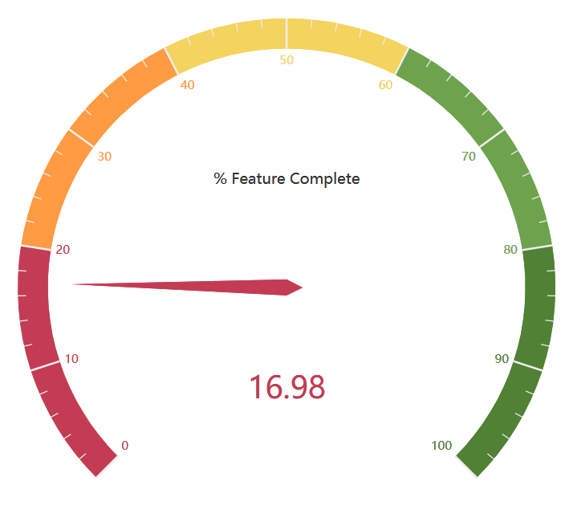
Data Lake Variant Results
Row Labels | Fully Implemented Features | Partially Implemented Features | Not Implemented Features
Cost Monitoring & Control | 0 | 0 | 4
Data Lake Topology | 2 | 0 | 4
DevOps | 0 | 0 | 3
Generic Upload to Azure Storage | 3 | 1 | 7
Logging, Alerting & Configuraton | 0 | 1 | 3
Scalability | 0 | 0 | 5
Security | 0 | 2 | 8
Staging Area Creation &-On Going Load | 1 | 0 | 2
Task Abstraction | 0 | 2 | 5
Grand Total | 6 | 6 | 41

Slide 6
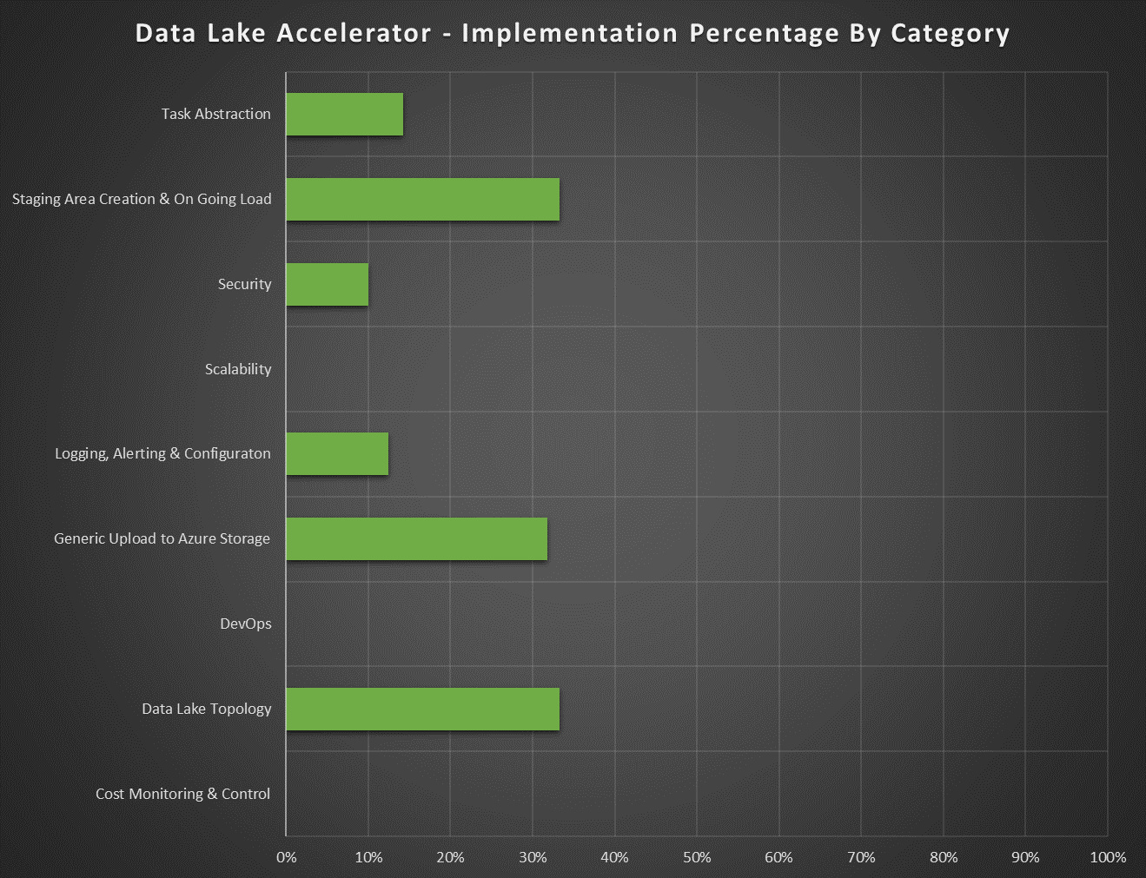
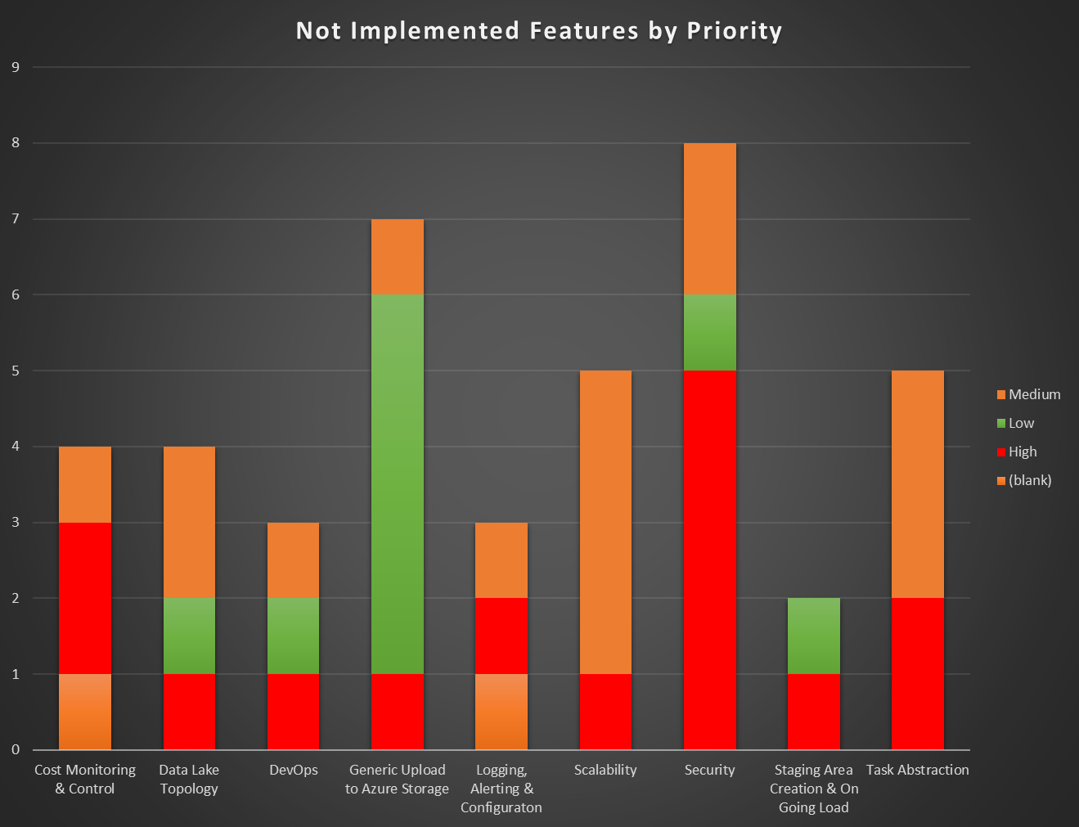
Data Lake Variant Results

Slide 7
Data Lake Variant Results – Partially completed & Not Implemented Items – High Priority

Slide 8
Data Lake Variant Results– Partially completed & Not Implemented Items – Medium Priority

Slide 9
Data Lake Variant Results – Partially completed & Not Implemented Items – Low Priority

Slide 10
Agile BI Variant Assessment

Slide 11
Use Data Lake Variant Assessment section slides as template for this section.

Slide 12
Modern Data Warehouse Variant Assessment

Slide 13
Use Data Lake Variant Assessment section slides as template for this section.

Slide 14
Machine Learning & Data Science Variant Assessment

Slide 15
Use Data Lake Variant Assessment section slides as template for this section.

Slide 16
Real Time Analytics Variant Assessment

Slide 17
Use Data Lake Variant Assessment section slides as template for this section.

